Slide 1

Nagy Dávid
Tokodi Mihály
Lehel Barnabás

Slide 2
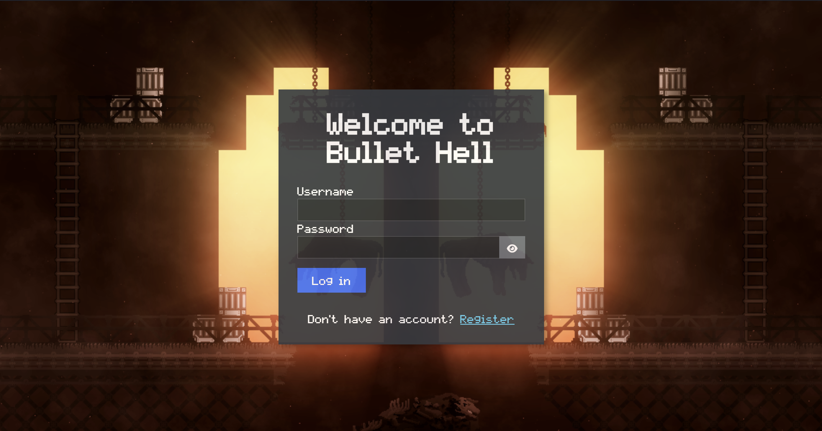
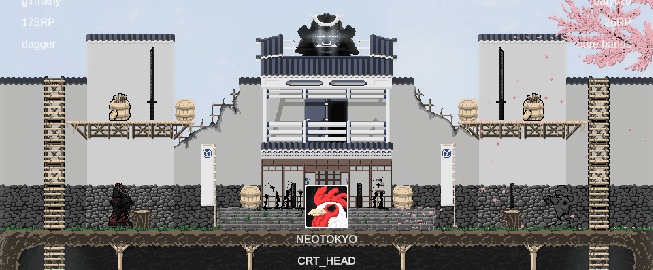
Overview

Slide 3
Areas of Responsibility
Nagy Dávid
Tokodi Mihály
Lehel Barnabás
- Game mechanics
- Weapon mechanics
- Character control
- Level design
- Graphic design
Database design
Security management
Admin functions
Frontend
Backend, API
Database design
Game API, Backend
Frontend
Codex functions

Slide 4
Project timeline
 | Sep | Oct | Nov | Dec | Jan | Feb | Mar | Apr
Game
Game API
Website
API
Assets
Dokumentáció
Lehel Barnabás
Nagy Dávid
Tokodi Mihály

Slide 5
Agenda
Website overview
Website DEMO
Challenges
Game overview
Game DEMO
Challenges
Summary

Slide 6
Website

Slide 7



Goals and Technology
-Target audience:
Bullet Hell Players
-Goal:
- encyclopedia
- Player profile
- Leaderboard
- Admin responsibilities

Slide 8
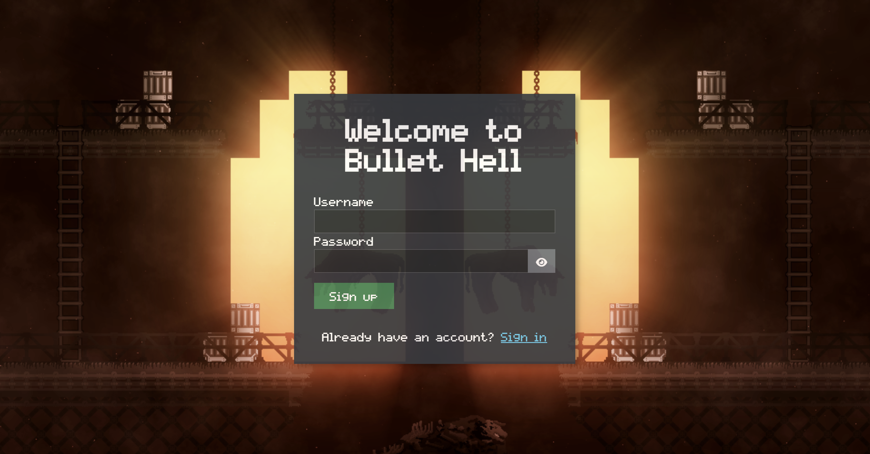
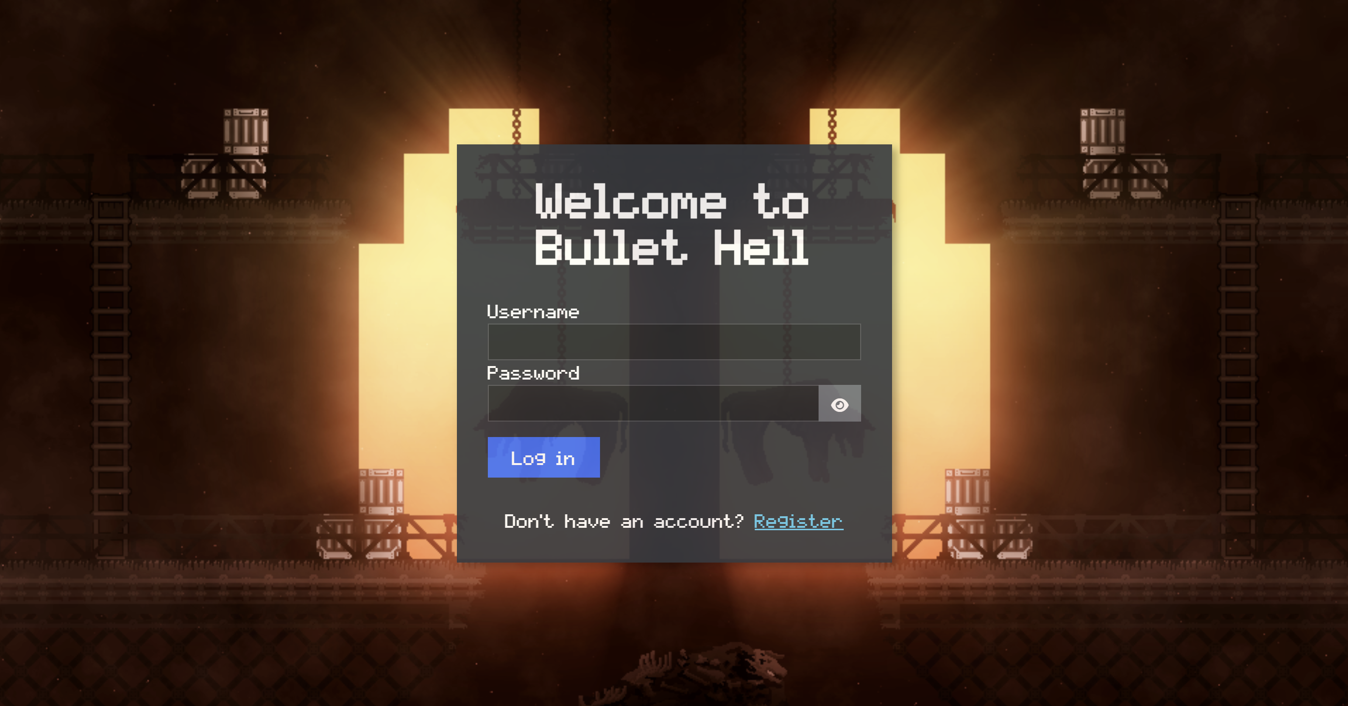
Login & Registration

Slide 9
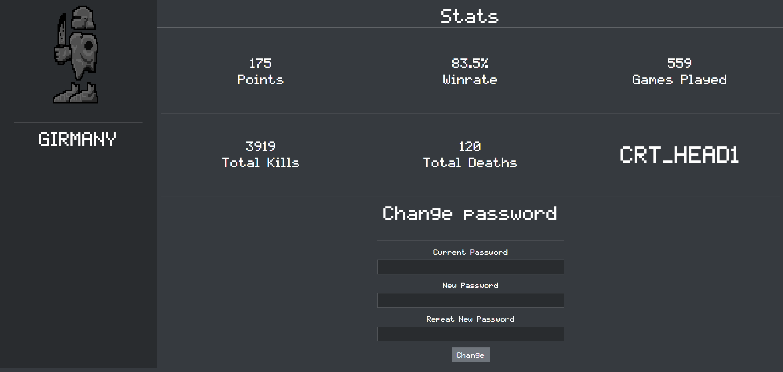
Navigation & Profile

Slide 10
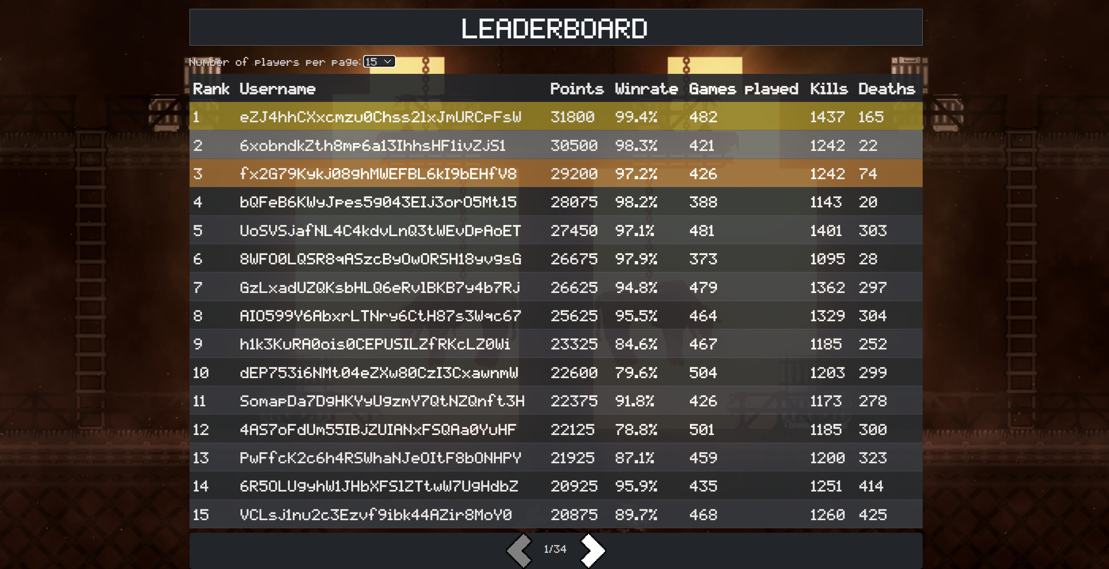
Leaderboard

Slide 11
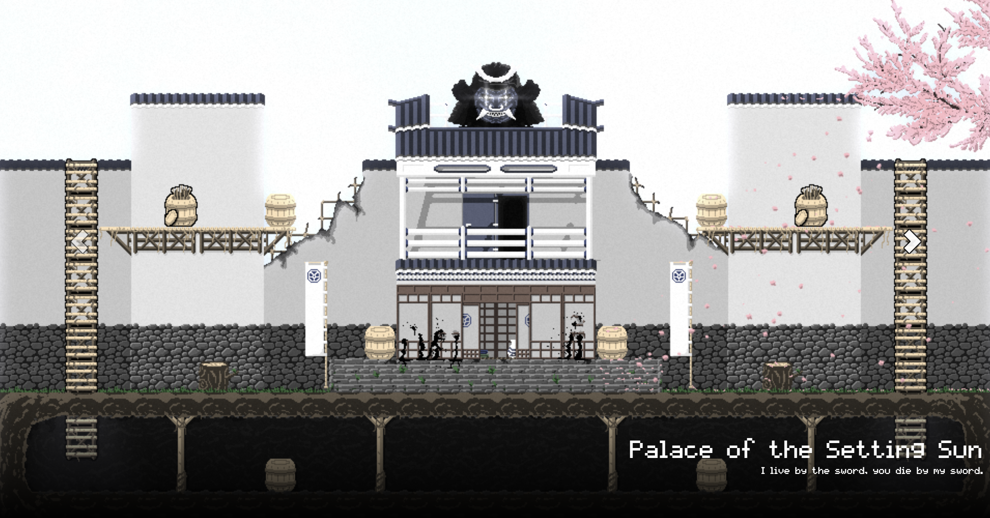
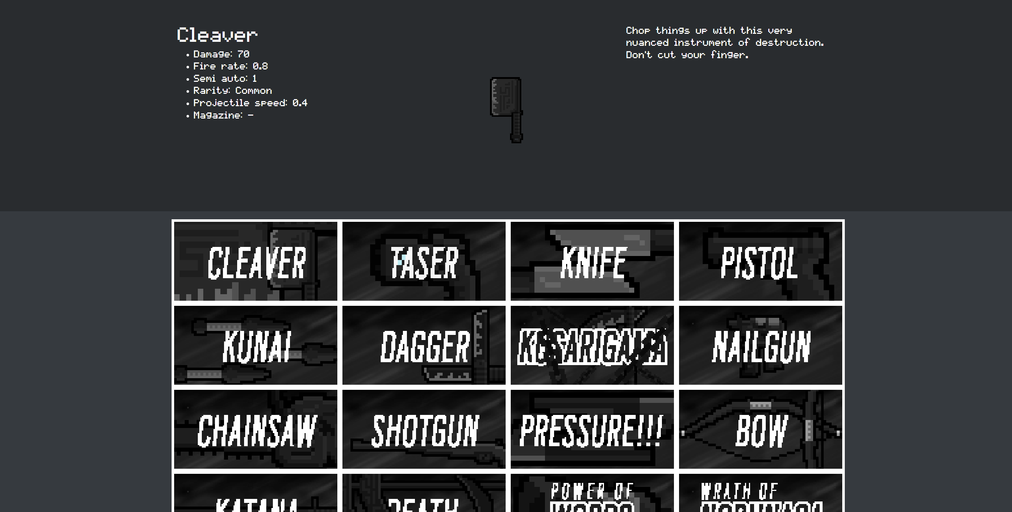
Codex - Maps, Weapons

Slide 12
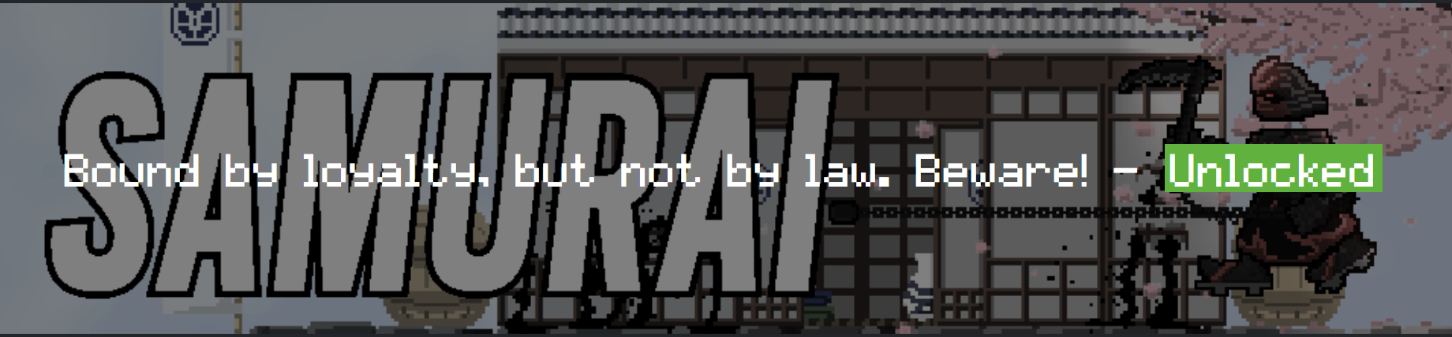
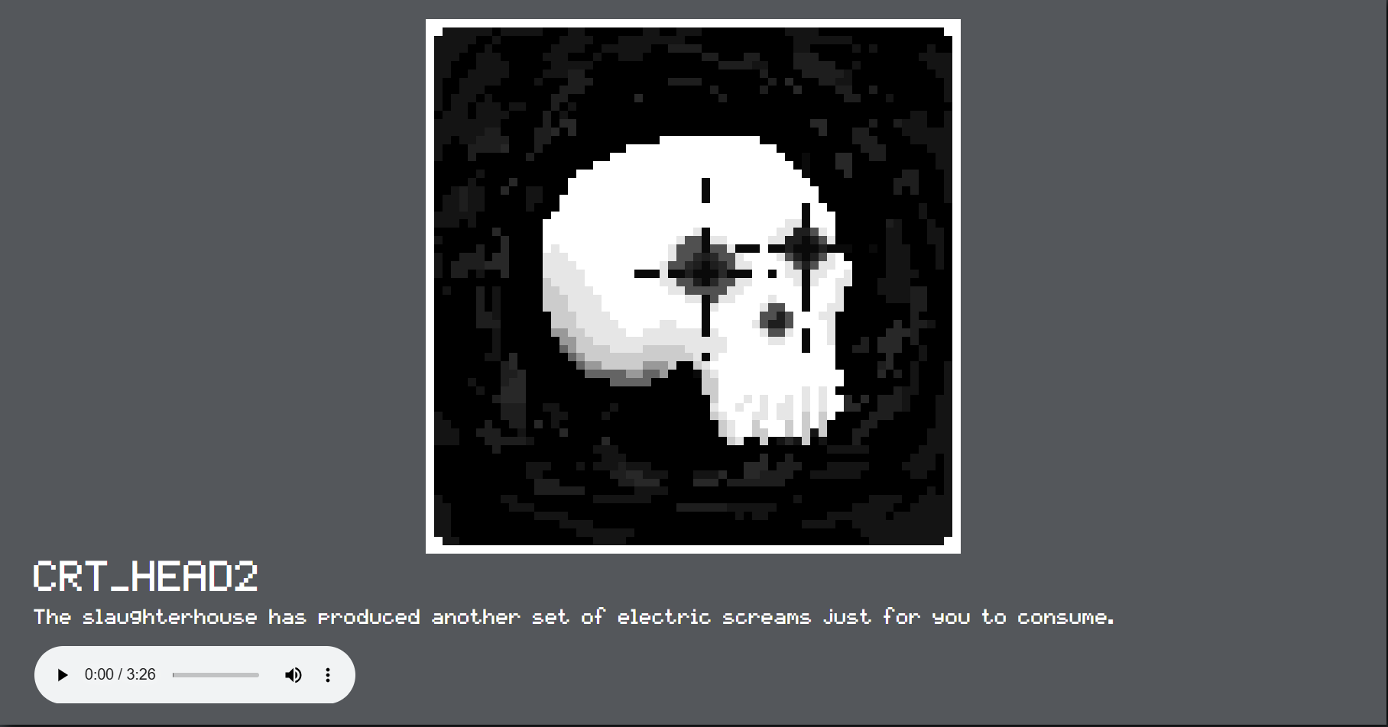
Codex - Characters, Music

Slide 13
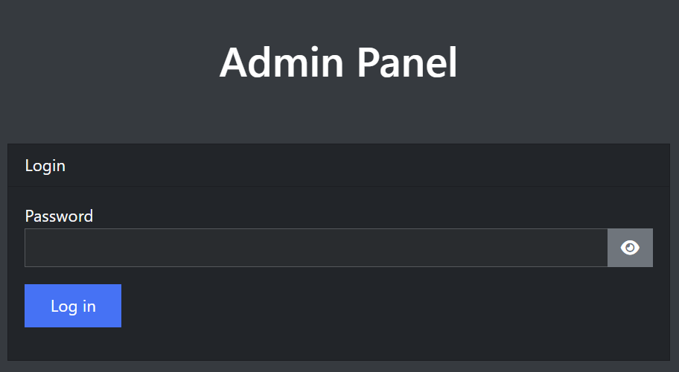
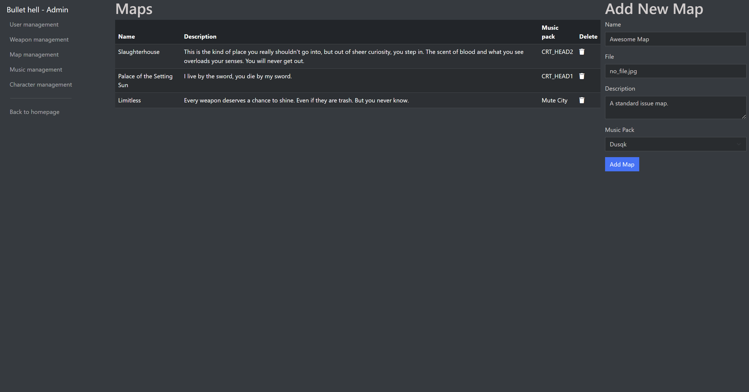
Admin panel

Slide 14
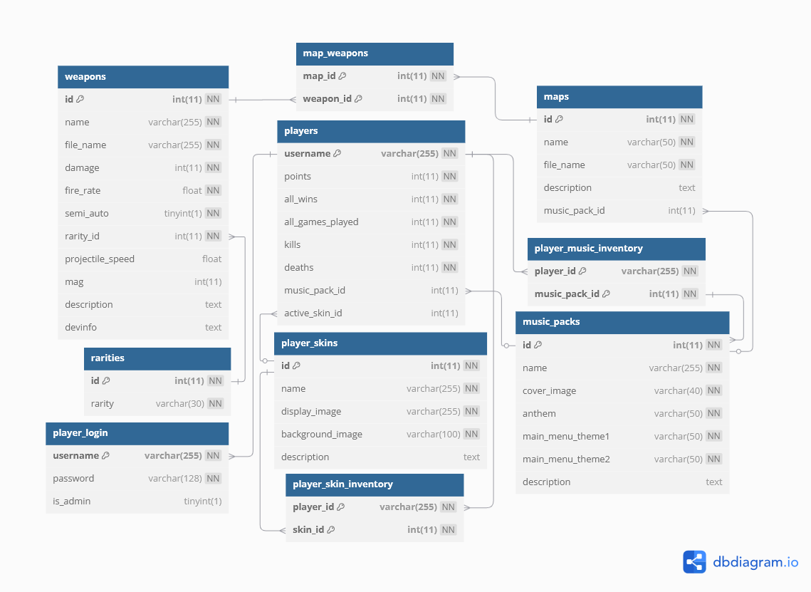
Database

Slide 15
Website - DEMÓ

Slide 16
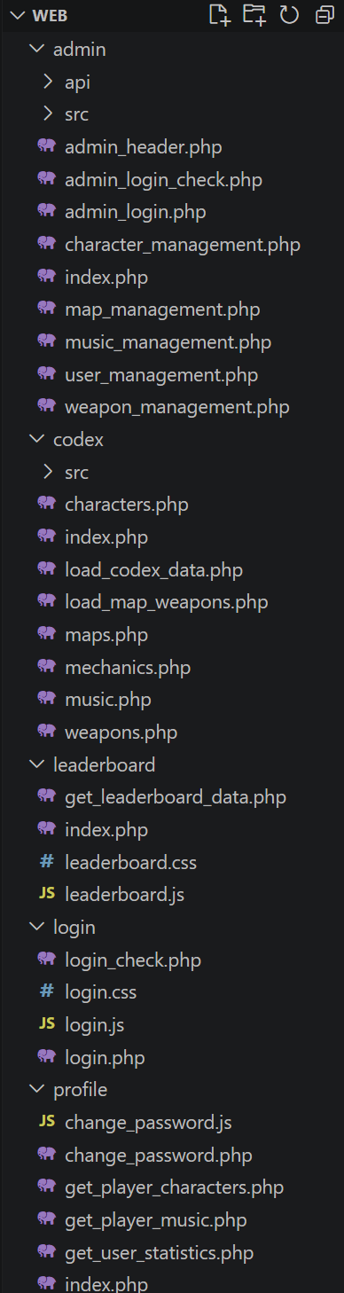
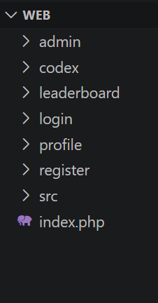
Structure

Slide 17
Challenges
- Writing our own API & jQuery, AJAX
- Login & Register system
Codex carousel, display
Table pagination
Safe database handling
Keeping the responsiveness

Slide 18
The game

Slide 19




Goals and Technology
- 1v1
- Skill based
- Local Multiplayer

Slide 20
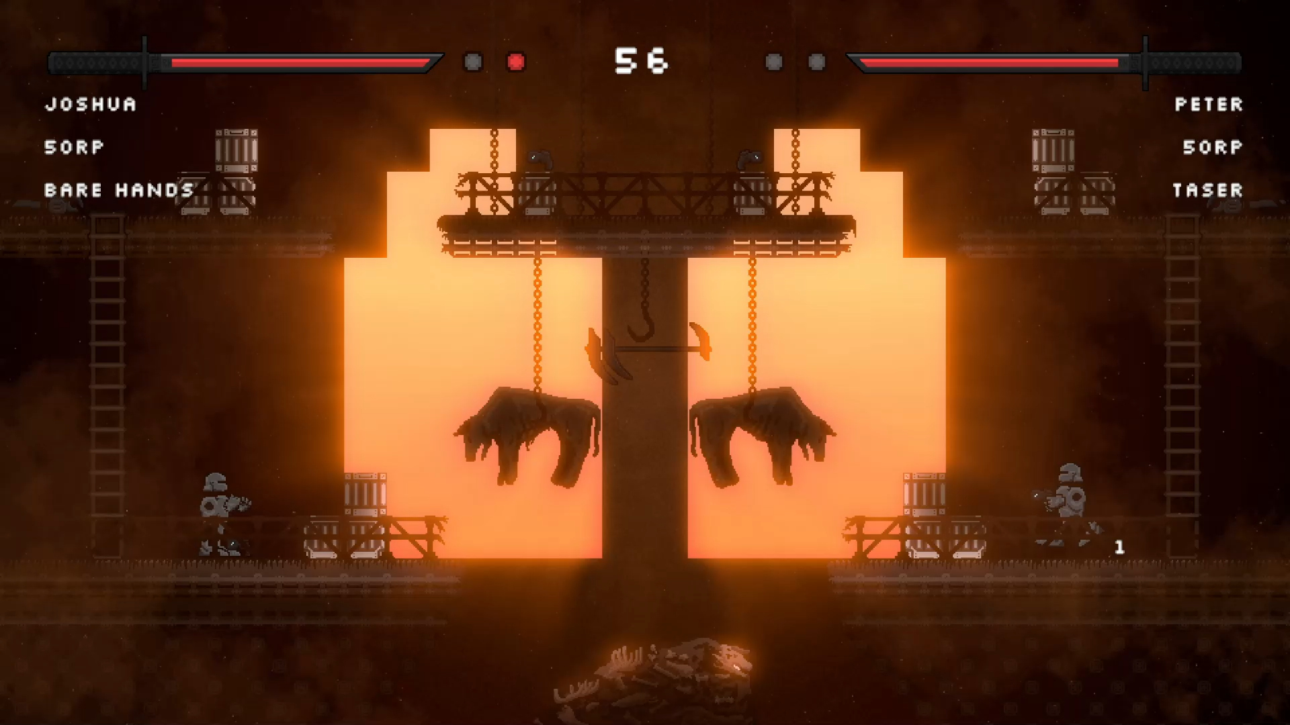
Gameplay

Slide 21
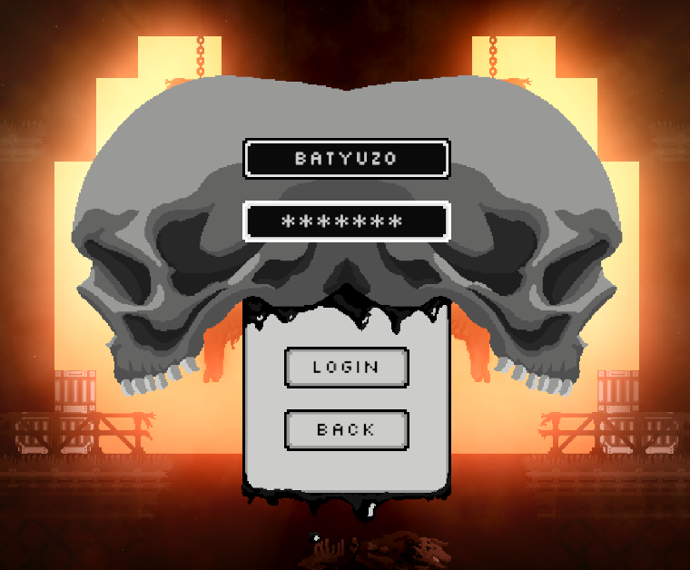
Login

Slide 22
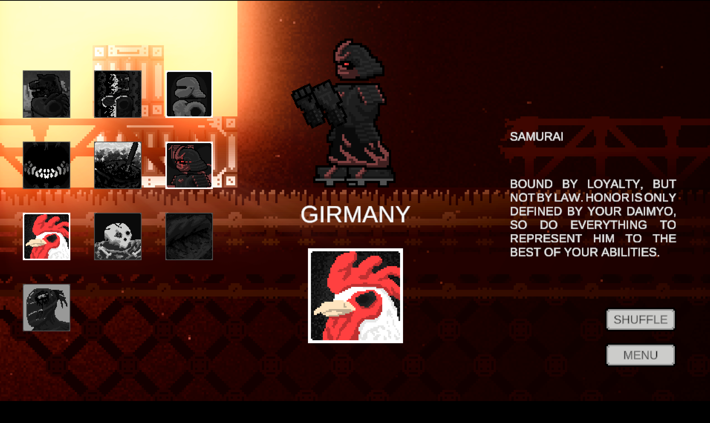
Characters, music

Slide 23


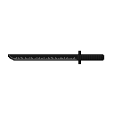

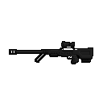
Weapons
Unique characteristics
Unique stats

Slide 24
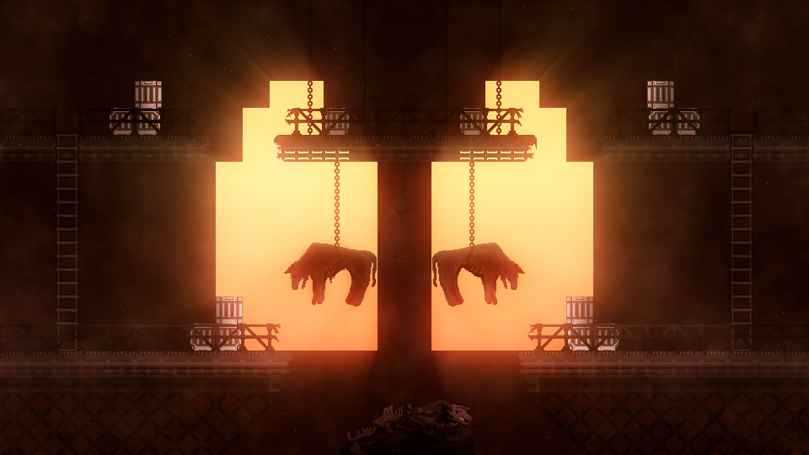
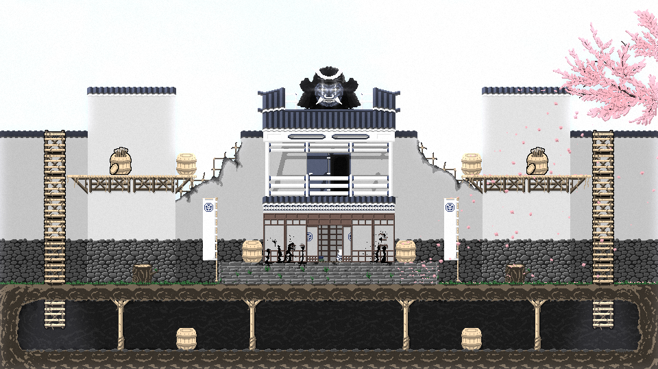
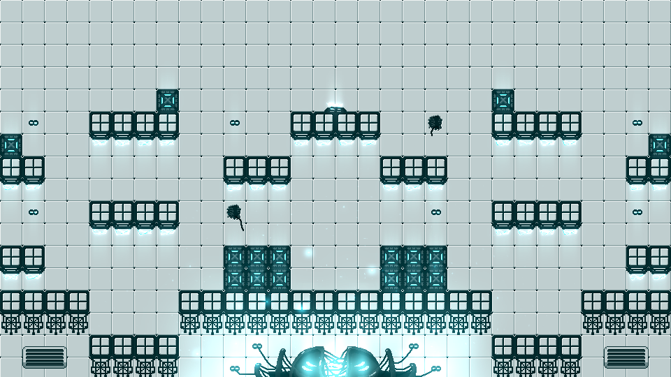
Maps

Slide 25
A game- DEMO

Slide 26
Challenges
- Writing our own API, UnityWebRequest
- Multiplayer controls
- Gameplay logics
- Combat system

Slide 27
Opportunities for further development
- Online multiplayer
- Making password handling safer
Pixel perfect font
More balanced game
More content
- Admin panel search and edit

Slide 28
Summary
- Game DONE
- Responsive website DONE
- API DONE
-Takeaways
- Unity & C# experience
- Full-Stack development
- Version control
- Teamwork

Slide 29
Thank you!

